Slide 1
Logistic Regression
By
Dr. S PADMANABHAN

Slide 2
Logistic Regression
Logistic regression is one of the most popular Machine Learning algorithms, which comes under the Supervised Learning technique.
It is used for predicting the categorical dependent variable using a given set of independent variables.
Logistic regression predicts the output of a categorical dependent variable. Therefore the outcome must be a categorical or discrete value. It can be either Yes or No, 0 or 1, true or False, etc. but instead of giving the exact value as 0 and 1, it gives the probabilistic values which lie between 0 and 1.

Slide 3
Logistic Regression
Logistic Regression is much similar to the Linear Regression except that how they are used.
Linear Regression is used for solving Regression problems, whereas Logistic regression is used for solving the classification problems.

Slide 4
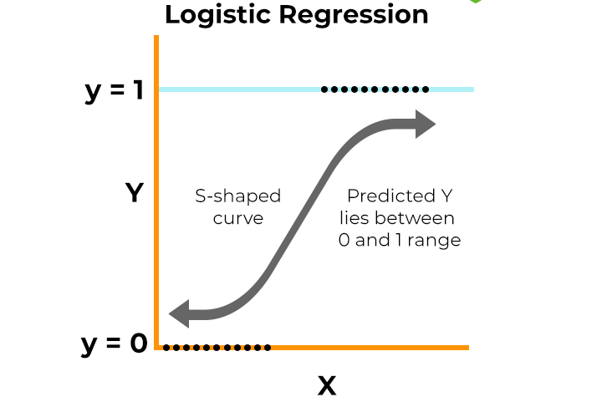
Logistic Regression
In Logistic regression, instead of fitting a regression line, we fit an "S" shaped logistic function, which predicts two maximum values (0 or 1).

Slide 5
Logistic Regression
The curve from the logistic function indicates the likelihood of something such as whether the cells are cancerous or not, a mouse is obese or not based on its weight, etc.
Logistic Regression is a significant machine learning algorithm because it has the ability to provide probabilities and classify new data using continuous and discrete datasets.
Logistic Regression can be used to classify the observations using different types of data and can easily determine the most effective variables used for the classification. The below image is showing the logistic function:

Slide 6
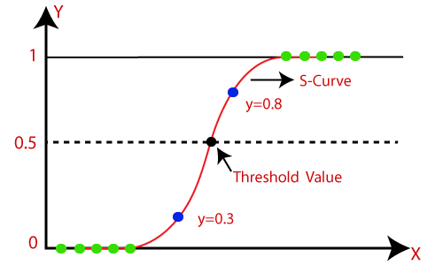
Note: Logistic regression uses the concept of predictive modeling as regression; therefore, it is called logistic regression, but is used to classify samples; Therefore, it falls under the classification algorithm.

Slide 7
Logistic Function (Sigmoid Function):
The sigmoid function is a mathematical function used to map the predicted values to probabilities.
It maps any real value into another value within a range of 0 and 1.
The value of the logistic regression must be between 0 and 1, which cannot go beyond this limit, so it forms a curve like the "S" form. The S-form curve is called the Sigmoid function or the logistic function.
In logistic regression, we use the concept of the threshold value, which defines the probability of either 0 or 1. Such as values above the threshold value tends to 1, and a value below the threshold values tends to 0.

Slide 8
Assumptions for Logistic Regression:
The dependent variable must be categorical in nature.
The independent variable should not have multi-collinearity.
No outliers: There should be no outliers in the dataset.
Large sample size: The sample size is sufficiently large

Slide 9

Logistic Regression Equation:
The Logistic regression equation can be obtained from the Linear Regression equation.
It is given by
Where z = w⋅X + b

Slide 10
Type of Logistic Regression:
On the basis of the categories, Logistic Regression can be classified into three types:
Binomial: In binomial Logistic regression, there can be only two possible types of the dependent variables, such as 0 or 1, Pass or Fail, etc.
Multinomial: In multinomial Logistic regression, there can be 3 or more possible unordered types of the dependent variable, such as "cat", "dogs", or "sheep"
Ordinal: In ordinal Logistic regression, there can be 3 or more possible ordered types of dependent variables, such as "low", "Medium", or "High".

Slide 11
Python code for implementing Logistic Regression using the popular scikit-learn library.
Steps to Implement:
Step 1: Import necessary libraries
Step 2: Load the dataset
Step 3: Exploratory Data Analysis (EDA) & Data Cleaning
Step 4: Split the dataset into training and testing sets
Step 5: Train the Logistic Regression model
Step 6: Make predictions
Step 7: Evaluate the model
Step 8: Visualize the results

Slide 12
Split the dataset into training and testing sets

Slide 13
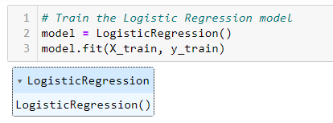
Train the Logistic Regression model

Slide 14

Make predictions

Slide 15
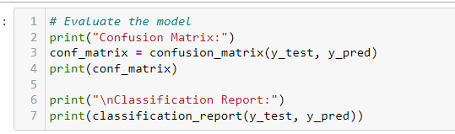
Evaluate the model

Slide 16
Step 8: Visualize the results
To visualize the results of the logistic regression model, we can create the following plots:
Confusion Matrix Heatmap: This will show the true positives, true negatives, false positives, and false negatives in a more visual format.
ROC Curve: As mentioned before, this plot shows the trade-off between the True Positive Rate and False Positive Rate at different threshold levels.
Precision-Recall Curve: Another useful plot, especially when dealing with imbalanced datasets, which shows the trade-off between precision and recall.

Slide 17
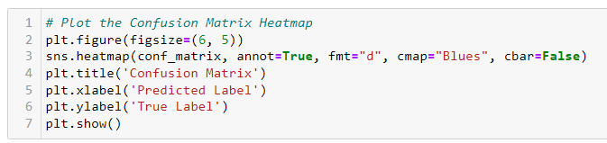
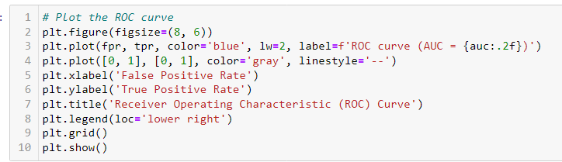

Slide 18
